Slide 1
ALGEBRA 4
Day 63

Slide 2
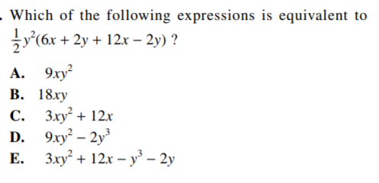
Bell Work

Slide 3
Bell Work Answer:
A
How many ways can work this problem and get the same answer?
Hint: Distribute then combine like terms… Combine like terms then distribute. Anything else? Which seems easier for you? Why?

Slide 4
ACT DAY 3
Abbreviated Test
Taking all 4 tests today (shortened version)
Mini Math Test 3 (in class/homework)

Slide 5
Abbreviated Test Pacing
Times for the abbreviated test today are approximate to stay consistent with the actual ACT Test pacing.
Your teacher will give you a warning at 1 minute remaining!
English (10 minutes 15 questions)
Math (15 minutes 15 questions)
Reading (10 minutes 11 questions)
Science (10 minutes 10 questions)

Slide 6
Directions for Today.
Be honest with yourself. This is not graded, Do your best!
Yes, the answers are on the last page… if you are worried you’ll check… tear the page off when you get it and put it out of sight.
Cheating on this now won’t help you later!
Please do not go past the END OF TEST {#} page until told to do so to better prepare you for the ACT.
If you finish a section early go back and check over your work from that test only.

Slide 7
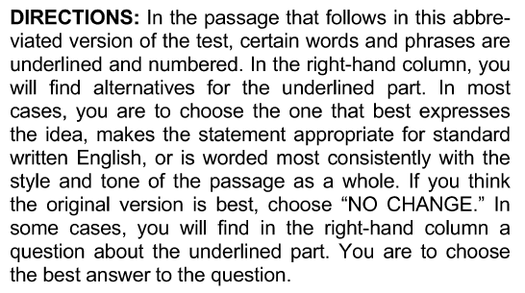
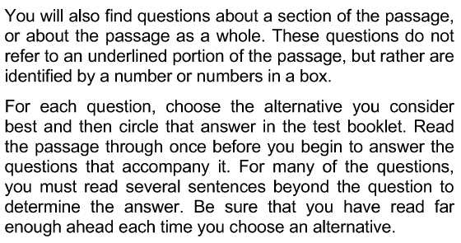
English Abbreviated Test
After reading through these directions as a
class. You will be told you have 10 minutes to complete the 15 questions.
If you finish early, do not work ahead. Spend any extra time reviewing your answers for this section.

Slide 8
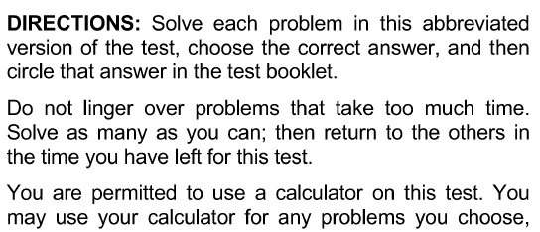
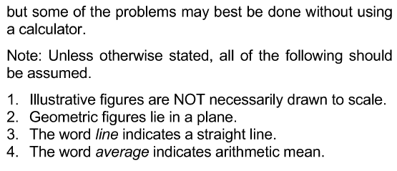
Math Abbreviated Test
After reading through these directions as a
class. You will be told you have 15 minutes to complete the 15 questions.
If you finish early, do not work ahead, and do not go back go previous sections. Spend any extra time reviewing your answers for this section.

Slide 9
Break
Take a 3 – 5 minute break to collect your thoughts before moving on to the last 2 sections.
During the actual ACT this will be your chance to go to the restroom and get a drink.
There won’t be time today since this is a shorter test.

Slide 10
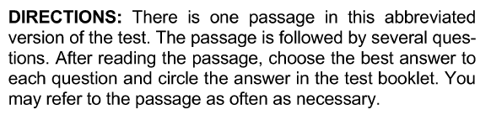
Reading Abbreviated Test
After reading through these directions as a class. You will be told you have 10 minutes to complete the 11 questions.
If you finish early, do not work ahead, and do not go back go previous sections. Spend any extra time reviewing your answers for this section.

Slide 11
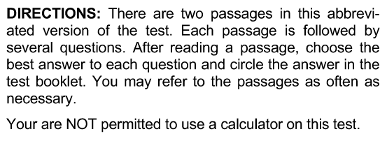
Science Abbreviated Test
After reading through these directions as a class. You will be told you have 10 minutes to complete the 10 questions.
If you finish early, do not work ahead, and do not go back go previous sections. Spend any extra time reviewing your answers for this section.

Slide 12
Catch Up…
Take 10-12 minutes to go back and review your work…
This won’t be allowed on the ACT, but as we practice I want you to try and catch your own mistakes, and/or finish the practice problems before we check them in class

Slide 13
Grading your Abbreviated Test
Be honest with yourself and go through your test and mark the problems you got correct, and the problems you got wrong.
You are going to grow more, and score higher on the test that counts if you are honest with yourself now so please do not feel the need to cheat.
If you miss them all, it doesn’t matter, we’ll be able to fix the small issues and move on before the actual test!

Slide 14
Look over the following example of the Writing part of the ACT…
We won’t actually ‘test’ on this today, but just so you can have an example of what the writing portion will look like… feel free to take a picture and think about how you would answer this prompt.
The first slide gives you the set up, and the second one asks you to start writing.

Slide 15
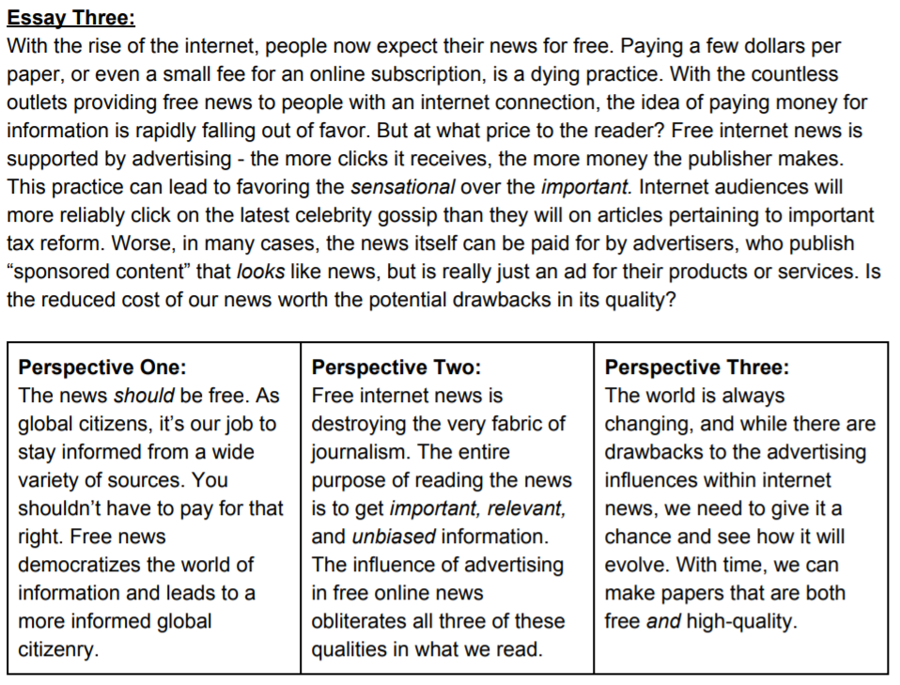

Slide 16
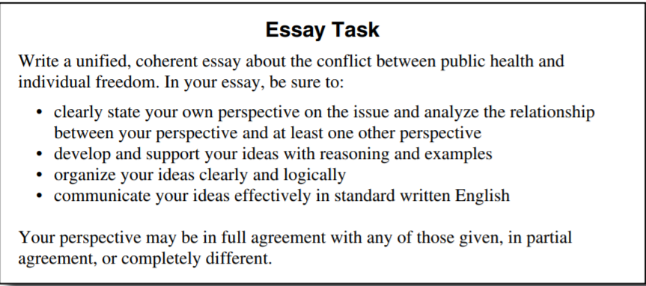

Slide 17
Homework/In class work for next time
Attempt Mini Test 3
Set a timer for yourself for 10 minutes and try to get all 10 problems done
-- OR --
Set a timer and work through all the problems until you are complete and see how long it took you.

